Slide 1

Project 3 – GROUP 2
“Oh, how the temperature blows”

Slide 2

The data and the why:
App Windy is a professional weather app that gives information about Temperature, Wind speed, and pressure.
The UK has quite an interesting weather, so having information about 20 different cities and their wind and temperature was insightful.
We can comfortably say that our weather enjoys throwing a tantrum every so often.

Slide 3
DATA ANALYSIS:
Questions to analyse:
1 - What are the changes in temperature within different cities in the UK?
2 - What are the changes in the wind within different cities in the UK?
3 - What is the average temperature within each UK region?
4 - What is the temperature trend in each city throughout the day?

Slide 4
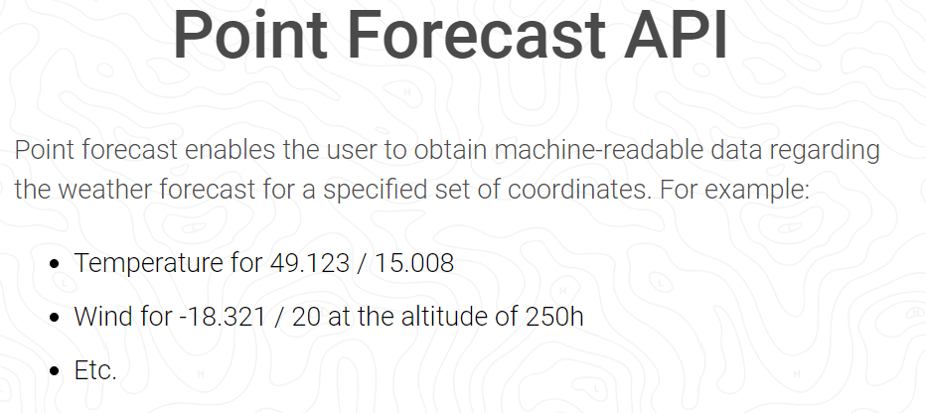
METHOD:
Extracted data from the API onto Jupiter notebook, where we cleaned and separated the dataset into two (temperature and wind speed).
We pushed the two datasets into 2 different CSVs.
On Flask App.py we created two SQLite databases using the two CSV datasets we just cleaned.

Slide 5
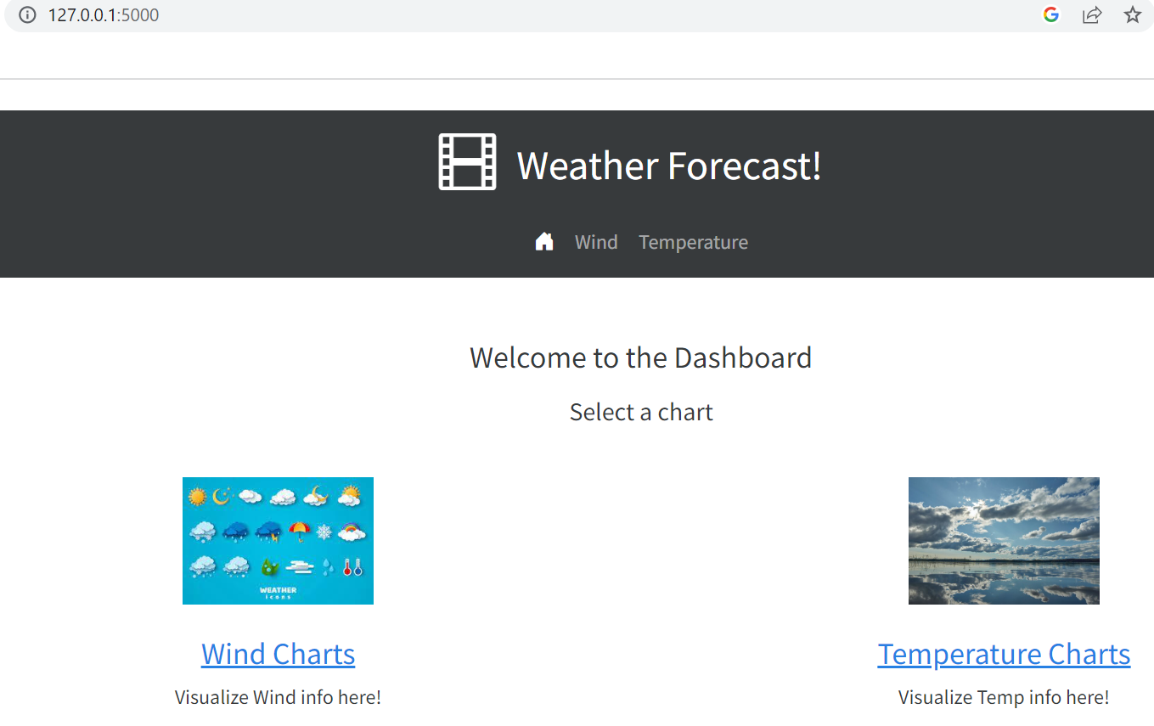
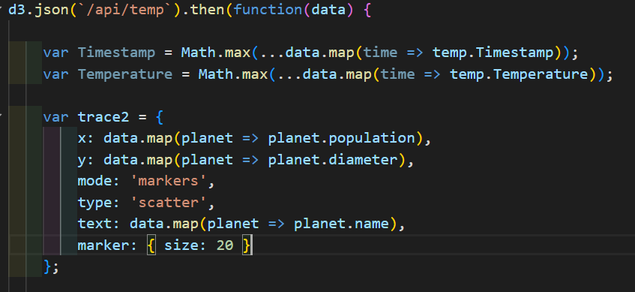
METHOd:
We created the front end of our website using a mix of HTML and CSS
We then connected it with Javascript pages which allowed us to analyse our dataset.
We used D3 and Plotly libraries.
App.py was used to call everything.

Slide 6
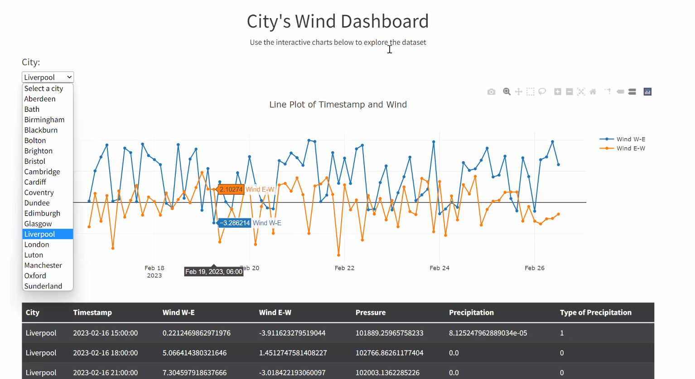
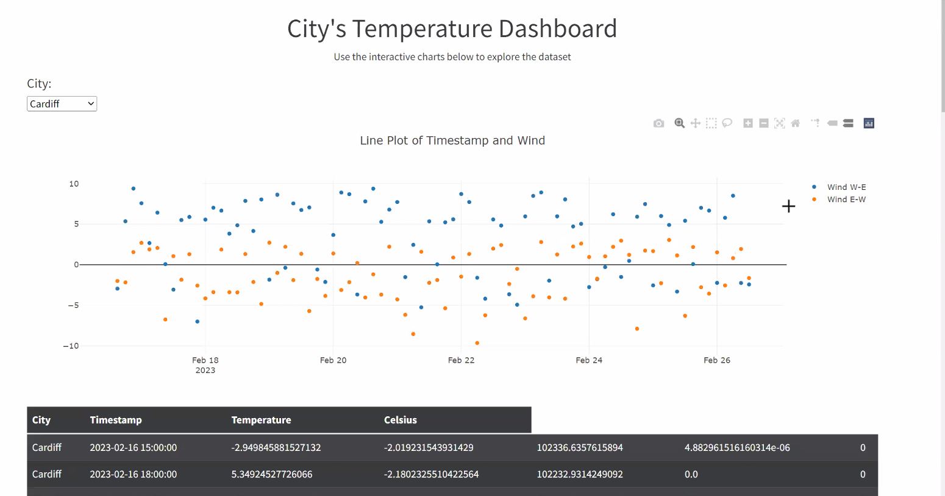
Visualisation:
Notes:
Due to time, experience, and confidence, we created showcased:
a scatter graph with the temperature at a certain time within different cities across the UK.
Ideally, we would have loved to showcase:
a scatter graph with the temperature at a certain time within different cities across the UK.
a line graph showcasing the trend in temperature or wind speed within each city every three hours.
a bar chart showcasing the average temperature or windspeed within each city during a week period
The possibilities are endless…

Slide 7
Challenges and Limitation
The project was as harsh as our winds during winter!
The limited experience, time, and confidence impacted us a lot.
We would have loved to use an extra library (such as charts) and since there are multiple possibilities for data analysis with the information extracted, it would have been fun to showcase our dataset differently.
Ideally it would have been good to have had more time to understand the concepts of Javascript and HTML.
We worked hard in understanding the concept and pushing ourselves to give our best work.

Slide 8

Thank you very much!
Tharusha, Priscilla, Jyothi, Ahmed

